Slide 1

Holding course: the keel and North Star of the enterprise Semantic Fabric
KNOWLEDGE-DRIVEN ANALYTICS · ARCHITECTURE & IT PARTNERSHIP
Enterprise access to Claude.ai and RDF Studio for ontology engineering, semantic mediation and governance, proven on the HR Advisory 360 pilot
Executive review · October 2026
Notes:
Framing: this is a tooling request, but the real subject is the architecture it accelerates. The keel is our deterministic semantic foundation; the North Star is where it takes the enterprise. Claude.ai and RDF Studio are design-time tools for engineering both, under the same governance we apply to human work. The HR Advisory 360 agent is the bounded proving ground.

Slide 2
Approve a 90-day, design-time proof of capability for the Semantic Fabric workbench
THE DECISION
What we ask
What it accelerates
What stays the same
Claude.ai Enterprise and RDF Studio for 3–5 modelers: a 90-day, design-time evaluation proven on the HR Advisory 360 agent.
Policy-to-axiom drafting, ontology authoring, mapping maintenance under schema drift, and SHACL quality rules with impact simulation.
Architecture sets standards, IT owns production, CI/CD and data governance are unchanged. Miss the criteria and we stop, with nothing to unwind.
Semantic Fabric · Keel & North Star
2
Notes:
Lead with the ask so the board knows what it is deciding. This does not change who owns production, platforms or standards. Emphasize the third card: an accelerator inside existing controls, not a new path to production, and a clean stop if the pilot misses the criteria we agree together.

Slide 3
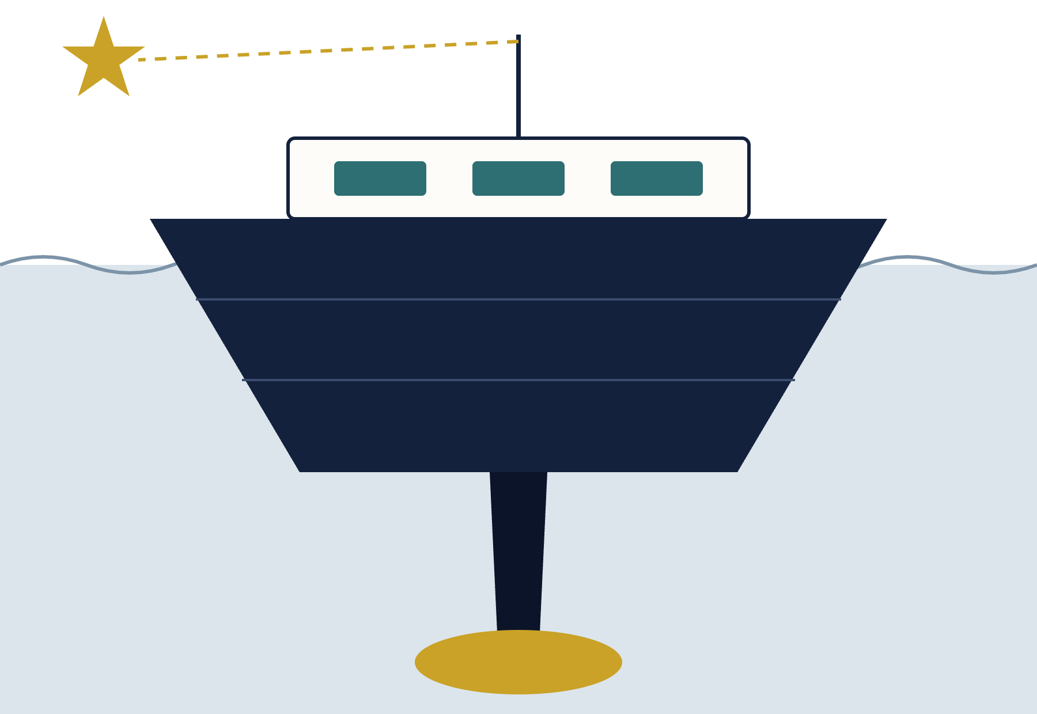
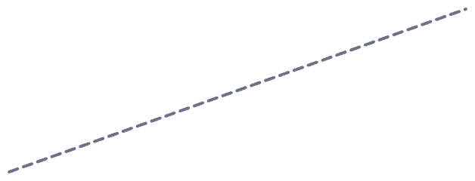
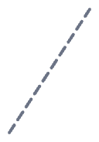

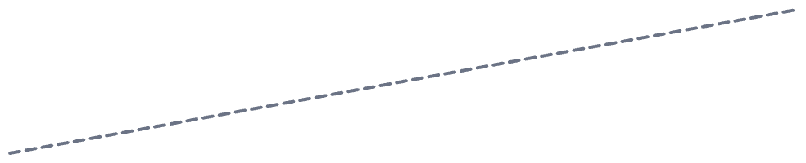
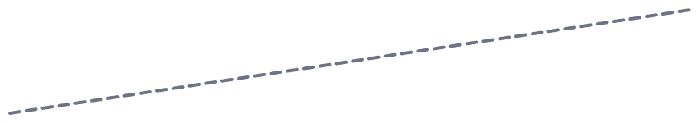
Deterministic semantics keep the fabric upright as the sea moves
THE KEEL
Superstructure · consumers
AI agents, analytics and applications ride high and dry, above all change.
North Star
Waterline · drift
Source schemas and external ontologies change constantly. That is the sea state.
Hull · virtualized mediation
Mapping agents and microservices absorb drift so consumers never feel it.
Keel · materialized graphs
Federated domain ontologies reconciled to one upper ontology: deterministic meaning.
Ballast · semantic governance
SHACL, reasoners, lineage and versioning: the weight that keeps the keel honest.
Semantic Fabric · Keel & North Star
3
Notes:
The keel metaphor: a keel does not steer, it resists being pushed sideways so the vessel can hold a heading. Our materialized ontologies play that role. The hull, our virtualized mediation layer, displaces the drift so consumers stay dry. Governance is the ballast: without it, a bigger ship just capsizes faster. Claude accelerates building every part of this vessel, but it never replaces the ballast.

Slide 4

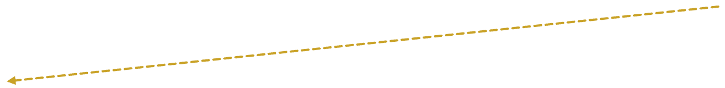
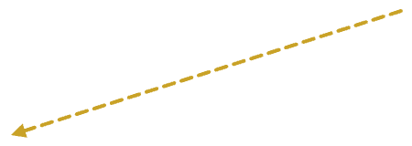
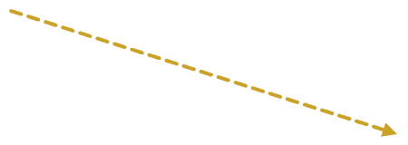
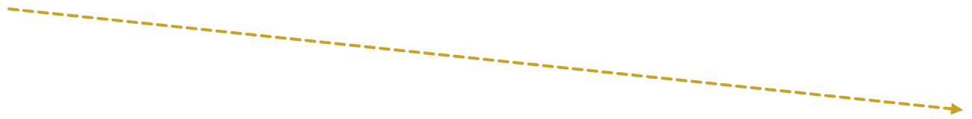

Every enterprise decision and AI answer rests on governed, traceable, unambiguous meaning
THE NORTH STAR
Trustworthy AI
Drift-proof integration
Audit-grade lineage
Business-owned meaning
Agents answer from governed semantics; ungated inference never propagates as fact.
Source changes are absorbed in the mediation layer, not in production consumers.
Every axiom, mapping and answer carries PROV-O provenance and a change log.
Policy changes land in governed models, not on IT's pipeline backlog.
H1 · HR Advisory 360 pilot
H2 · federated domains at scale
H3 · self-correcting semantic fabric
Semantic Fabric · Keel & North Star
4
Notes:
The North Star is the heading, not the destination. Four outcomes follow from it; the fourth comes from the KDA case: knowledge treated as a business-owned asset. The horizons show sequencing: H1, the HR Advisory 360 pilot, is the only commitment in this request; H2 and H3 are the direction the keel lets us hold.

Slide 5

Business first. Architecture and IT as partners.
OPERATING MODEL · WHO STEERS
Insights, answers and refinement requests flow back to the business
STEP 1 · BUSINESS
STEP 2 · ENTERPRISE ANALYTICS
STEP 3 · IT SERVICES
Owns the meaning
Makes meaning computable
Runs it reliably at scale
Job architectures & leveling
Pay, leave & sabbatical rules
Definitions of record
Taxonomies in RDF Studio
Axiom drafts in Claude.ai
Mappings, SHACL, impact sims
Workday, ServiceNow, lakehouse
Stable IRI-grounded endpoints
CI/CD, security, SSO
Sets the North Star
Builds the keel
Sails the ship
ARCHITECTURE · GUARDRAILS AT EVERY STEP, NOT JUST A GATE AT THE END
IRI & naming conventions
Reference patterns
ARB checkpoints
Security & SSO
Semantic Fabric · Keel & North Star
5
Notes:
From the KDA case, Figure 1. The business decides what is true and so sets the heading. Enterprise Analytics turns intent and rules into governed models: it builds the keel. IT Services receives governed models and runs them: it sails the ship. Architecture provides guardrails at every step, not only a gate at the end. Answers and refinement requests flow back to the business, closing the loop.

Slide 6


Three layers, one governance spine, one design-time workbench
ARCHITECTURE
Consumers · HR Advisory 360 · analytics · apps
Design-time workbench
Virtualized graph & mediation layer
Governance spine
Mapping agents
Semantic microservices
RML · SPARQL CONSTRUCT
RDF Studio models. Claude.ai drafts axioms, mappings and SHACL.
SHACL validation
DL reasoner checks
Impact simulation
Peer review · CI/CD
PROV-O lineage
Materialized knowledge graphs
Proposes. Never publishes.
Upper / unifying ontology
HR domain
Domain ontology
Domain ontology
Workday · ServiceNow · lakehouse · external ontologies
Semantic Fabric · Keel & North Star
6
Notes:
Read bottom to top: Workday, ServiceNow and the lakehouse keep exposing data through the REST endpoints and SQL views IT already manages. The virtualized graph layer binds them to canonical IRIs in the materialized graphs, rather than building another physical warehouse. Consumers such as the HR Advisory 360 agent only ever see canonical semantics. The design-time workbench feeds drafts into both layers; governance is the gate every change passes through.

Slide 7
Two design-time tools with distinct, non-overlapping roles
THE SHIPWRIGHT'S TOOLS
RDF Studio · the canvas
Claude.ai · the co-pilot
Where analysts and data stewards structure the domain together: jobs, locations, benefits, compliance classes.
Removes syntax friction: turns policy manuals into candidate SKOS concepts, mappings and constraints.
Visual taxonomy and ontology design
Graphical view of classes and relationships
Central repository for enterprise vocabularies
Canonical schema inspection and versioning
Drafts OWL axioms from written policy
Generates RML / SPARQL mapping drafts
Produces SHACL shapes for data quality
Simulates impact and flags breaking diffs
People review and approve every draft. Neither tool writes to a shared repository or runs in production.
Semantic Fabric · Keel & North Star
7
Notes:
RDF Studio is where the keel is laid out and inspected; Claude.ai drafts the parts. Example of Claude's role: an analyst states "Senior Advisory roles require Grade 12+ and jurisdictional licensing in California"; Claude drafts the matching SHACL shape; the shape is validated in RDF Studio with logged results for every test scenario. Claude also reads external frameworks such as O*NET alongside corporate job descriptions and proposes alignment candidates for analysts to review.

Slide 8



One change through the HR Advisory 360 lifecycle
HOW WE DELIVER TOGETHER
DESIGN-TIME · ENTERPRISE ANALYTICS SANDBOX
RUN-TIME · IT PRODUCTION
Business
Raise the need
next question or refinement
Use governed answers
HR policy owners
Policy change or a new advisory question
HR Advisory 360, audit-ready lineage
Enterprise Analytics
Model the meaning
Validate the model
Modelers & stewards
RDF Studio canvas; Claude.ai drafts
SHACL rules, impact & drift simulation
Architecture
Set guardrails first
Conformance review
Standards & review
IRI conventions & reference patterns
Patterns, security & data classification
IT Services
Enable the sandbox
Promote via CI/CD
Run & publish
Platforms & ops
SSO / RBAC, read-only source views
Regression tests & Git peer review
Stable, IRI-grounded endpoints
Semantic Fabric · Keel & North Star
8
Notes:
From the KDA case, Figure 2. The business starts the change, Enterprise Analytics shapes and validates it, Architecture engages twice (up front to set standards, and before promotion to confirm conformance), and IT promotes and runs it through processes it already owns. Everything left of the dashed line happens in the design-time sandbox; nothing crosses into IT-owned production without CI/CD, regression testing and peer review.

Slide 9

When a source schema changes, consumers never notice
DRIFT INSULATION
01
02
03
04
05
Drift detected
Claude.ai drafts the delta
Deterministic gates
Engineer approves
Registry publishes
Workday renames a field behind its REST endpoint or SQL view.
Peer review in Git; nothing merges on model output alone.
New mapping version with lineage; canonical IRIs unchanged.
Structural diff plus updated RML / SPARQL rules, with rationale.
SHACL shapes, reasoner consistency and regression SPARQL pass.
Today · point-to-point ETL
Target · mediated fabric
Vendor schema changes ripple into pipelines and dashboards, creating unplanned work for IT.
One governed mapping update; reports and agent APIs keep querying the same canonical IRIs.
Semantic Fabric · Keel & North Star
9
Notes:
This is the hull doing its job. Step 2 is the only step Claude owns, and it produces a draft. Steps 3 and 4 are deterministic gates and human judgment. The consumer-facing contract, the canonical IRIs, never moves. In the pilot we test this directly by simulating quarterly SaaS upgrades.

Slide 10


Design-time tools, run-time discipline
THE BOUNDARY
DESIGN-TIME · ENTERPRISE ANALYTICS
SHARED PROMOTION GATE
RUN-TIME · IT SERVICES
Git peer review
HR Advisory 360 agent: governed answers
RDF Studio: visual ontology and SKOS modeling, versioning
Human review of each change
Claude.ai: drafts axioms, mappings and SHACL; simulates impact
Stable IRI-grounded endpoints
ARB conformance
Architecture checkpoint
In: metadata, conceptual schemas, synthetic test sets
Virtualized graph layer: RML / SPARQL
CI/CD regression
Out: versioned models and SHACL suites in Git
IT-owned pipeline
Workday · ServiceNow · lakehouse
No production PII/PHI ever enters the modeling environment.
No bypass: generated code gets the same scrutiny.
IT owns production change; schema shifts stop at the mapping layer.
Semantic Fabric · Keel & North Star
10
Notes:
From the KDA case, Figure 4. Claude.ai and RDF Studio stay in the Enterprise Analytics sandbox and work only with metadata and synthetic data. Every model crosses the same shared promotion gate as any other code. What this asks of IT: a sandbox and read-only metadata access. What IT gets back: tested, reviewed semantic assets and fewer business-rule changes landing in pipelines. This is the invariant that keeps ungated inference from ever being laundered into production fact.

Slide 11
Accountability stays where it lives today
WHO DOES WHAT
Activity | Business | Enterprise Analytics | Architecture | IT Services
Define business terms, policies & rules | A / R | C | I | I
Model taxonomies & ontologies in RDF Studio | C | A / R | C | I
Draft axioms, mappings & SHACL with Claude.ai | I | A / R | C | I
Set IRI, prefix & reference-pattern standards | I | C | A / R | C
Validate quality & simulate change impact | C | A / R | I | C
Architecture conformance review (ARB) | I | R | A | C
Promote via CI/CD, regression & peer review | I | R | C | A
Operate endpoints, security, SSO & access | I | C | C | A / R
Accept the business outcome | A | R | I | I
A accountable · R responsible · C consulted · I informed. Enterprise Analytics does the semantic work but never holds accountability for business meaning, standards or production.
Semantic Fabric · Keel & North Star
11
Notes:
From the KDA case, Figure 3. Read across the Enterprise Analytics column: it is responsible for the semantic work in between, but accountability for business meaning, architecture standards and production stays with the teams who own them today. This is the answer to "is this a shadow platform?" No.

Slide 12
Pilot hypotheses: what changes, and how we will measure it
VALUE
Dimension | Today | Semantic Fabric approach | Pilot target (to measure)
Ontology authoring | Manual authoring bottlenecks domain federation | Claude.ai drafts SKOS / OWL; RDF Studio curates | 60–75% shorter authoring and refactoring cycles
Cross-system analysis | Analysts reconcile Workday, ServiceNow and policies by hand | One semantic layer links profiles, rules and job frameworks | Up to 70% faster time-to-insight on complex HR questions
Absorbing schema change | Vendor changes ripple into pipelines and dashboards | Virtualized mappings absorb change in one governed place | No report or agent changes for simulated SaaS upgrades
Compliance & traceability | Hard to show why a policy path was recommended | PROV-O provenance traces every rule that fired | Audit-ready lineage for every pilot answer
All targets are hypotheses, baselined with IT and HR in weeks 1–3 and reported at the readout.
Semantic Fabric · Keel & North Star
12
Notes:
The 60 to 75 percent authoring figure comes from the Semantic Fabric business case; the 70 percent time-to-insight figure comes from the KDA case. Neither is a measured result. Present both as hypotheses the pilot will confirm or correct.

Slide 13




Guardrails that hold regardless of who authors the change
WHAT STAYS THE SAME
Ownership
Access
Data
Review
Architecture remains the authority for IRI conventions and patterns. IT Services remains sole owner of production.
Claude.ai Enterprise via corporate Okta / SAML SSO and RBAC. Inputs and outputs not used for training.
Conceptual schemas, metadata and anonymized synthetic test sets only. No production PII or PHI.
Every artifact passes CI/CD, regression tests and Git peer review. No exceptions for generated code.
Semantic Fabric · Keel & North Star
13
Notes:
Security will ask about data residency and retention; have the enterprise terms ready. The data-handling rule is the strongest control: we work on models and synthetic test sets, not production data. Existing data classification and privacy rules apply unchanged.

Slide 14
Four phases, five success criteria, one shared go / no-go
THE 12-WEEK PILOT
Weeks 1–3
Weeks 4–7
Weeks 8–10
Weeks 11–12
Environment & setup
HR 360 semantic modeling
Validation & agent tests
Readout
3–5 seats, SSO / RBAC and sandbox; agree prefixes; baseline the measures
Core HR taxonomy in RDF Studio; mappings and policy axioms drafted with Claude.ai, all peer-reviewed
SHACL suites, drift and impact simulations against mock HR queries
Joint readout; continue, adjust or stop
Success criteria, confirmed jointly in weeks 1–3
Measured reduction in time-to-answer for an agreed set of complex HR policy questions
Simulated source schema changes absorbed in the mapping layer, with no downstream report or agent changes
100% of promoted artifacts pass CI/CD regression tests and Git peer review
Architecture conformance sign-off on pilot models and mappings
Zero production PII/PHI in the modeling environment for the duration of the pilot
Semantic Fabric · Keel & North Star
14
Notes:
Architecture involvement: conventions working session in weeks 1–3, optional check-in in weeks 4–7, conformance review in weeks 8–10, co-present at readout. IT involvement: SSO/RBAC and sandbox, read-only metadata access, CI/CD onboarding guidance, co-present at readout. The readout goes to IT Services, the ARB and the HR Technology Steering Committee.

Slide 15

What we ask of each partner
DECISION REQUESTED
Architecture
IT Services
Procurement
Conventions session in weeks 1–3, conformance review in weeks 8–10, a shared voice at readout.
SSO / RBAC for 3–5 seats, a sandbox with read-only metadata access, CI/CD onboarding guidance.
90-day evaluation licensing for Claude.ai Enterprise and RDF Studio.
Open questions for your guidance
Which IRI namespace and prefix conventions should the pilot adopt, or should we draft one for ARB review?
What data classification applies to model metadata and synthetic test sets?
Which repository and CI/CD pipeline should pilot artifacts use?
Are there review points Architecture or IT would like added to the 12-week plan?
Notes:
Our commitment: we build on the standards and processes Architecture and IT already own, keep all work in the design-time sandbox, and make every decision about production jointly. The keel is already being built; this request makes it faster to build and safer to maintain, while the North Star stays fixed.

